Slide 1
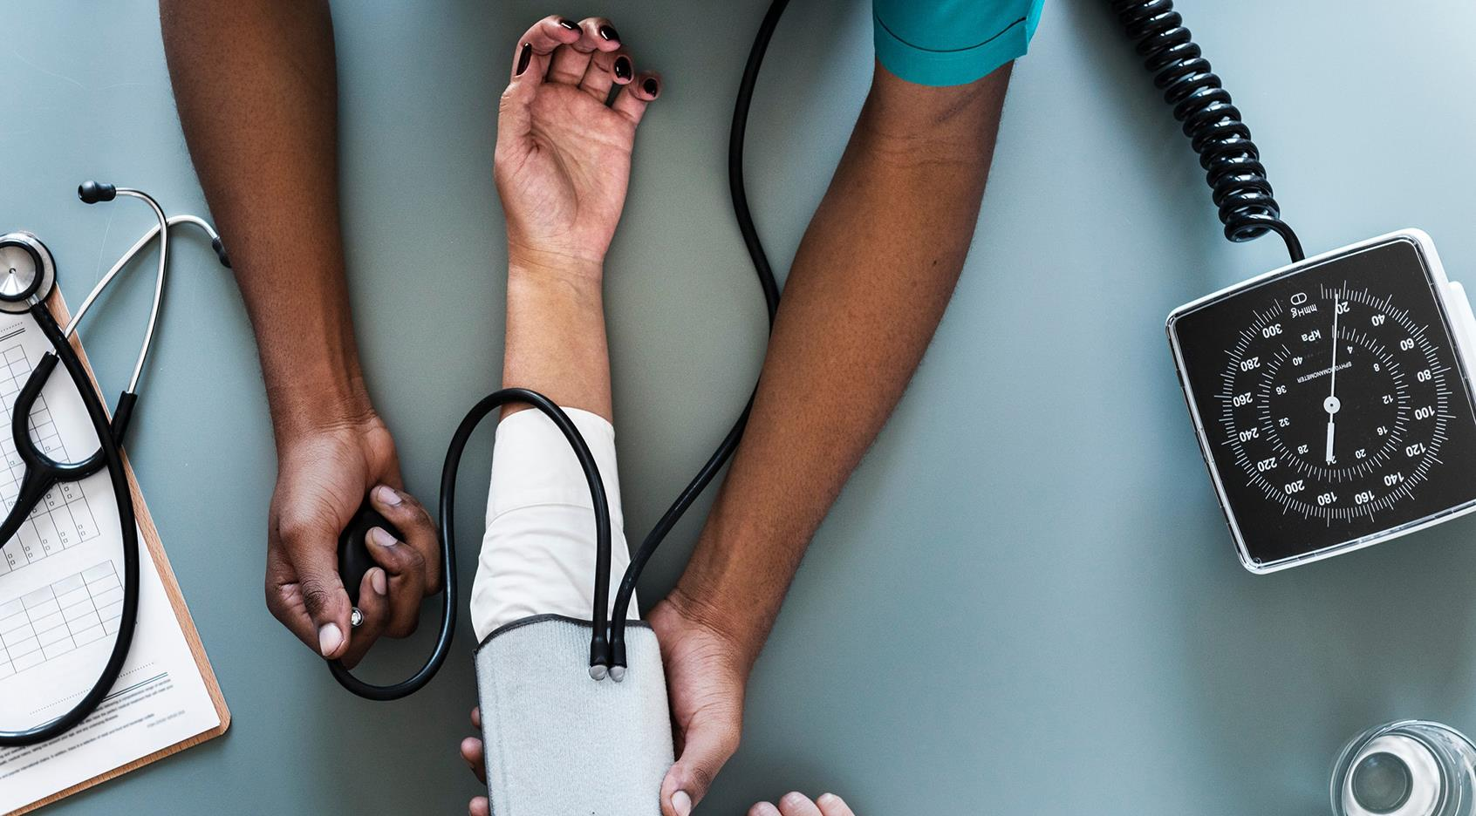
- Presented by 18B81A05Q1 - P.Aadesh Kumar 18B81A05S0 - M.Krishna Sai Prahlad 18B81A05S1 – Gattu Lohitha
Title of the Project:
Prediction of Kidney disease
by Data Mining Algorithms
Name of the Supervisor : Mrs. A. Swathi
Assoc.Prof.
Date of Presentation:19th June,2021.

Slide 2
Problem Statement & Proposed Solution:
Problem Statement: Prediction of Chronic Kidney Disease using DM Algorithms.
Idea:
Kidney Disease Prediction using various Machine Learning Algorithms as Support Vector Machine, k-nearest Neighbors , Artificial Neural Networks and identifying the accuracy variations for each algorithm.
Analyze the results obtained with each algorithm and listing out the best algorithm among 3 developed solutions.
Deploying the Model onto web platform and get the user details through and show the result (prediction) to the user by post processing the model.
.

Slide 3
Technology Stack Dataset Sources: Kaggle Tools: Jupyter heroku Frameworks: Tensorflow Sklearn Pandas
Numpy Phases of Development
Phase 1: Exploratory Data Analysis
Determining the features of Dataset, Data cleaning, Separation of features and classification, Pre processing the Dataset, Splitting dataset into Training and Testing.
Phase 2: Building Models with Algorithms
Building various Machine Learning Models using their respective algorithms, obtaining the accuracy, Choosing best model among the three proposed algorithms.
Phase 3:Deployment
Deployment of Model in Flask, and showing results on web UI, deployment of flask web app in Heroku.

Slide 4
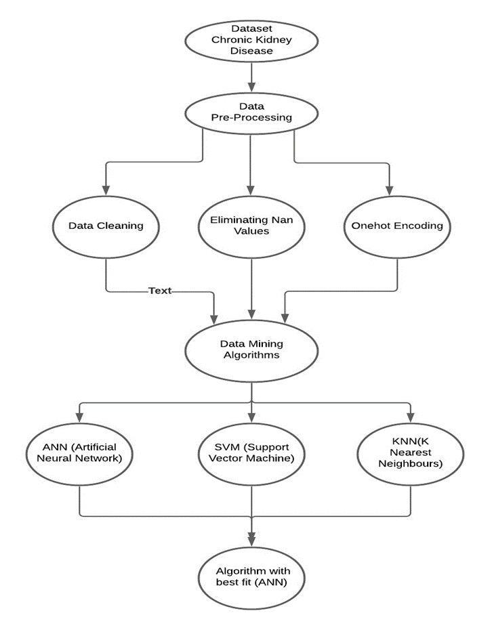
Architecture

Slide 5
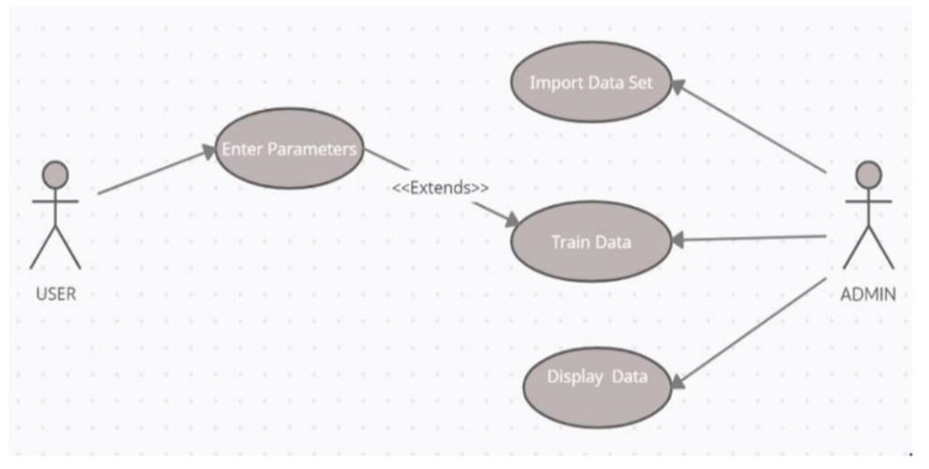
Use case Diagram :

Slide 6
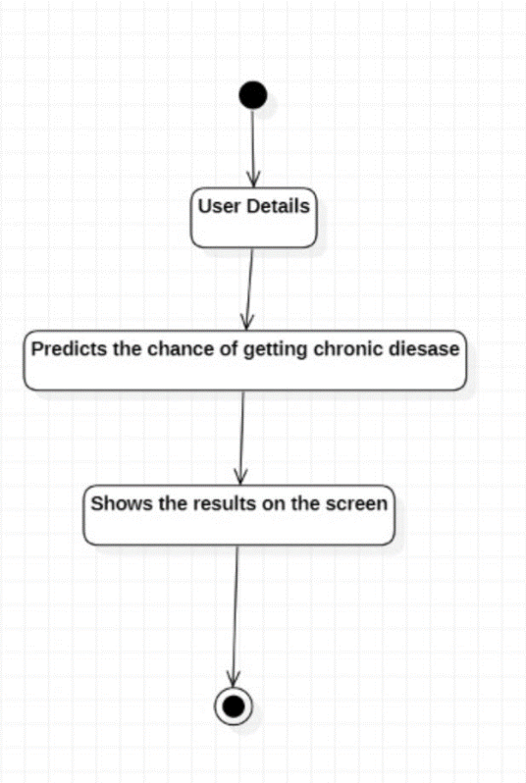
Activity Diagram

Slide 7
Phase 1 & Phase 2:
Exploratory Data Analysis:
Downloaded the dataset from Kaggle and loaded onto jupyter notebook and performed pandas operation to read and explore the dataset using dataframes.
Extracted unique values in each feature, deleted Nan values, changed the datatypes of strings to numbers all over the csv.
Changed Boolean values to 0 and 1 (one-hot encoding).
Splitted the features and classification into separate dataframes.
Splitting into training and testing data with 4:1 ratio.
Built a model with Support Vector machine algorithm using sklearn library.
Obtained a result of 88% accuracy.
Built a model with K-nearest neighbours' algorithm using sklearn library.
Obtained a result of 98% accuracy.
Prahlad

Slide 8
Phase 2:
Observed the implementation of KNN algorithm and SVM algorithm, analyzed the accuracy of each algorithm.
Built a model using tensorflow framework with Artificial Neural Network algorithm.
Obtained accuracy of 99.57%.
Analysed that this algorithm has got the highest accuracy and tensorflow framework provides various methods to convert model into .h5 .pkl .model formats.
Computed a .pkl model using pickle library, which can be further used to flask deployment.
Post processing of user inputs obtained from the web app in flask.
Technique used is MinMaxScalar to do pre and post processing of input values to the model.
Aadesh

Slide 9
Phase 3:
Designed html page and CSS styling sheet for the web User interface.
Built a flask app with the designed html page.
Provided GET/POST requests for the flask app, to take inputs from html and push prediction on to the web browser.
Deployed model into flask with .pkl extension.
Post Processing in the flask application after receiving the form data from html.
Completed a full working flask application on localhost.
Installed Heroku cli into local machine.
Deployed flask application in Heroku and obtained a url.
The web-url is https://chron-web-sai.herokuapp.com/
Lohitha

Slide 10
Results:
Algorithm | Accuracy
ANN | 99.50
KNN | 98.27
SVM | 88.4
Conclusion:
By exploratory data analysis, Artificial Neural Network is capable of extracting features with better accuracy than KNN, SVM algorithms.
Future Enhancements:
In the coming days, we want to train the model only time period base with the live data by mounting it on to any cloud service. Thus , there would be better accuracy in predicting the disease.

